Slide 1
Topic Modeling
What is Topic?

Slide 2
Motivation
Suppose you’re given a massive corpora and asked to carry out the following tasks
Organize the documents into thematic categories
Describe the evolution of those categories over time
Enable a domain expert to analyze and understand the content
Find relationships between the categories
Understand how authorship influences the content

Slide 3
Topic Modeling
A method of (usually unsupervised) discovery of latent or hidden structure in a corpus
Applied primarily to text corpora, but techniques are more general
Provides a modeling toolbox
Has prompted the exploration of a variety of new inference methods to accommodate large-scale datasets

Slide 4
Example 1
Dirichlet-­‐multinomial regression (DMR) topic model on ICML (Mimno & McCallum, 2008)

Slide 5
Example 2

Slide 6
Example 3
Manual
LDA
SLDA

Slide 7
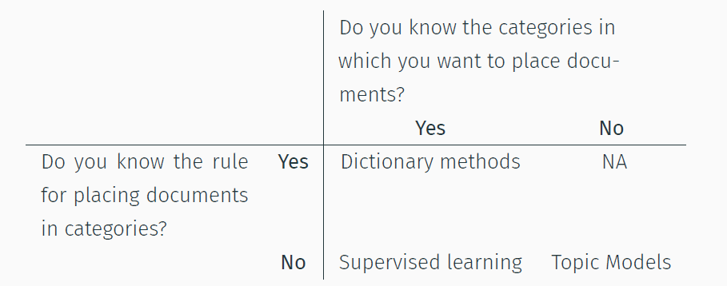
Topic Modeling

Slide 8
Topic Modeling
Topic models are algorithms for discovering the main themes in an unstructured corpus
They require no prior information, training set, or labelling of texts before estimation
They allow us to automatically organize, understand, and summaries large archives of text data
  Uncover hidden themes.
  Annotate the documents according to themes.
  Organize the collection using annotations.

Slide 9
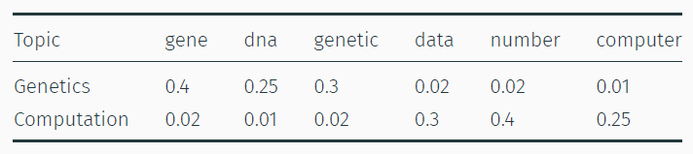
What is a “topic”
Google: “a matter dealt with in a text or conversation”
Topic models: probability distribution over a fixed word vocabulary
Consider a vocabulary: gene, DNA, genetic, data, number, computer
When speaking about genetics, you will:
  Frequently use the words “gene”, “DNA” & “genetic”
  Infrequently use the words “data”, “number” & “computer”
When speaking about computation, you will:
  Frequently use the words “data”, “number” & “computer”
  Infrequently use the words “gene”, “DNA” & “genetic”

Slide 10
Topic Modeling
What is Topic?

Slide 11
Topic Modeling
Latent Dirichlet Allocation (LDA)

Slide 12
Introduction

Slide 13
Introduction
  Each topic is a distribution over words
  Each document is a mixture of corpus-wide topics
  Each word is drawn from one of those topics

Slide 14
Introduction
  In reality, we only observe the documents
  The other structure are hidden variables

Slide 15
Introduction
  Our goal is to infer the hidden variables
  i.e., compute their distribution conditioned on the documents
  P(topics, proportions, assignments | documents)

Slide 16
Introduction
  Topic modelling allows us to extrapolate backwards from a collection of documents to infer the topics that could have generated them.

Slide 17
Latent Dirichlet Allocation (LDA)
The LDA model is a Bayesian mixture model for discrete data where topics are assumed to be uncorrelated
LDA provides a generative model that describes how the documents in a dataset were created
Each of the 𝐾 topics is a distribution over a fixed vocabulary
Each document is a collection of words, generated according to a multinomial distribution, one for each of 𝐾 topics
Inference consists of estimating a posterior distribution over the
Parameters of the probability model from a combination of what is
Observed (words in documents) and what is hidden (topic and word parameters)

Slide 18
Details
For each document, the LDA generative process is:
  randomly choose a distribution over topics (multinomial of length 𝐾)
  for each word in the document
    Probabilistically draw one of the 𝐾 topics from the distribution over topics obtained in step 1, say topic 𝑘 (each document contains topics in different proportions)
    Probabilistically draw one of the V words from 𝛽_{𝑘} (each individual word in the document is drawn from one of the K topics in proportion to the document’s distribution over topics as determined in previous step)
The goal of inference in LDA is to discover the topics from the collection of documents, and to estimate the relationship of words to these, assuming this generative process.

Slide 19
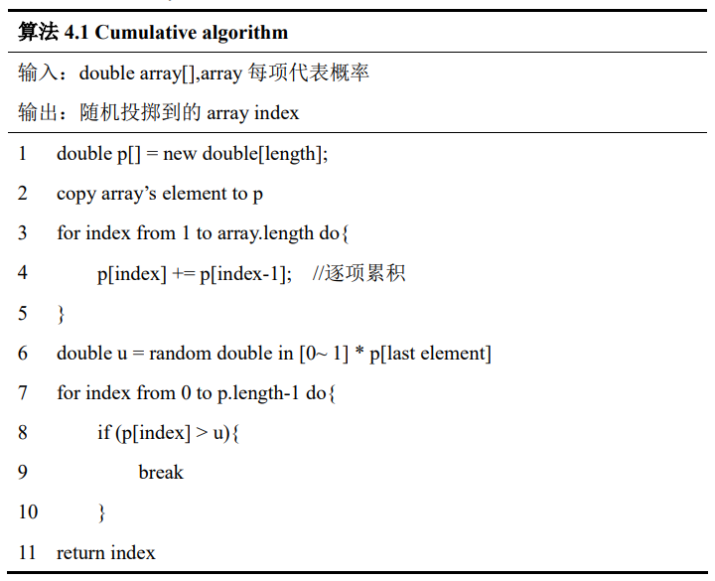
Algorithm

Slide 20
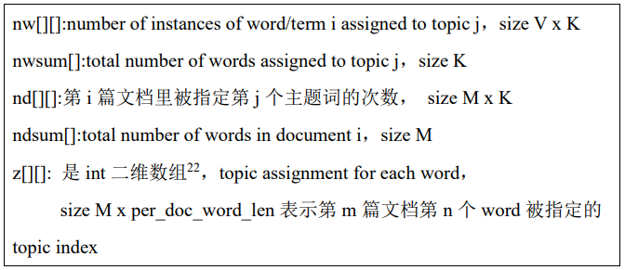
Algorithm

Slide 21
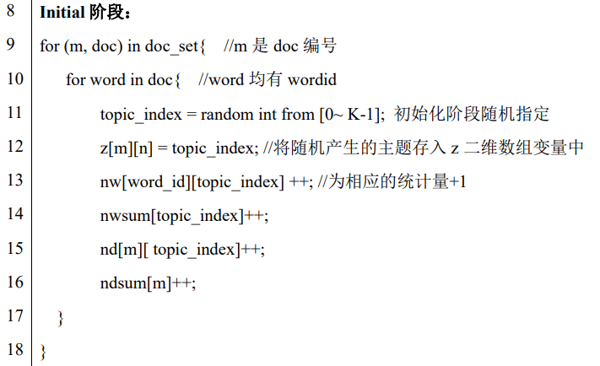
Latent Dirichlet Allocation: Algorithm

Slide 22
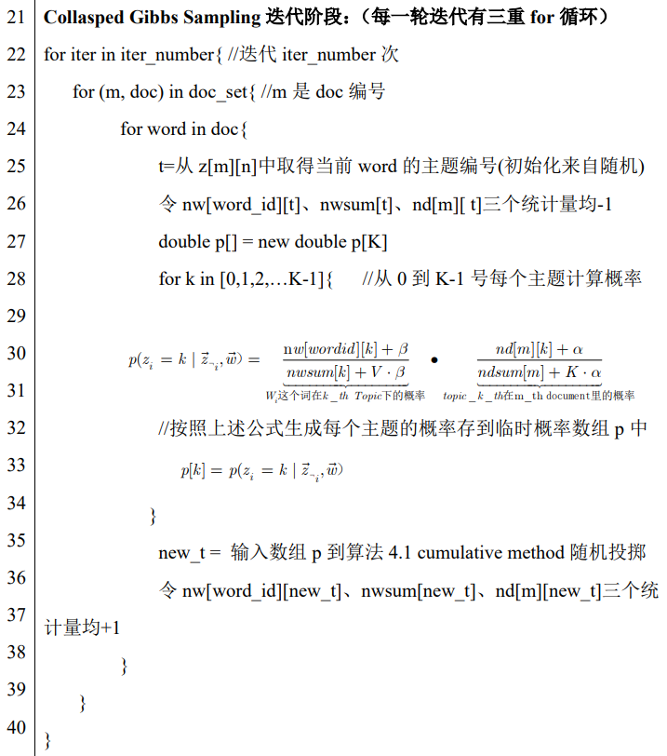
Algorithm

Slide 23
Algorithm

Slide 24
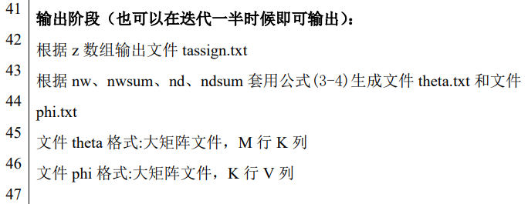

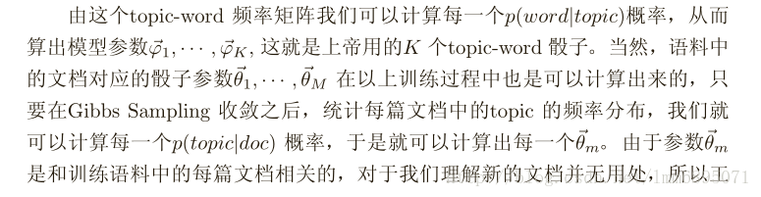
Algorithm

Slide 25
Parameters
Topic number K:许多读者问，如何设置主题个数，其实现在没有特别好的办法，目前只有交叉验证（cross validation）：通过设置不同的 K 值训练后验证比较求得最佳值。
α和β：这个超参数其实作为伪计数，不是很影响算法的结果。
iter_number：gibbs sampling 前面 1000 次甚至更多可以抛弃，这样会达到更好的效果。

Slide 26
Topic Modeling
Latent Dirichlet Allocation (LDA)

Slide 27
Topic Modeling
LSI、HDP、……

Slide 28

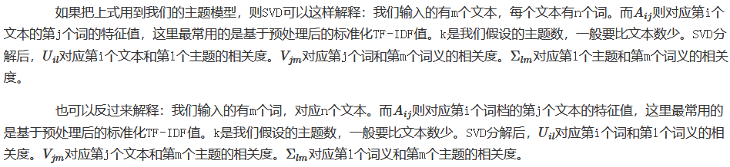
Latent Semantic Indexing (LSI)
潜在语义索引(Latent Semantic Indexing,以下简称LSI)，有的文章也叫Latent Semantic Analysis（LSA）。其实是一个东西，后面我们统称LSI，它是一种简单实用的主题模型。LSI是基于奇异值分解（SVD）的方法来得到文本的主题的。

Slide 29
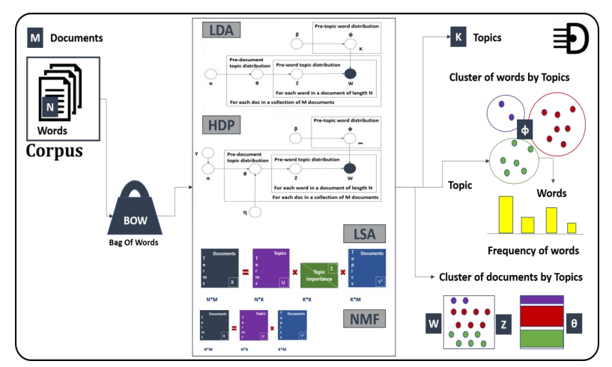
Hierarchical Dirichlet Process (HDP)
LDA的改进；
无需人工确
定主题数量K。

Slide 30
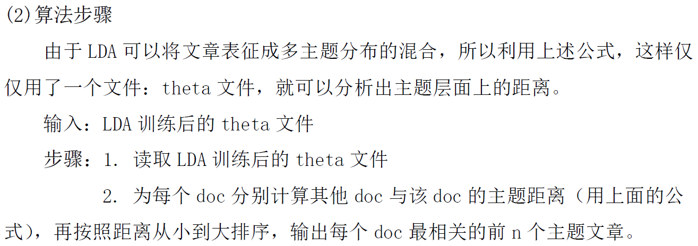
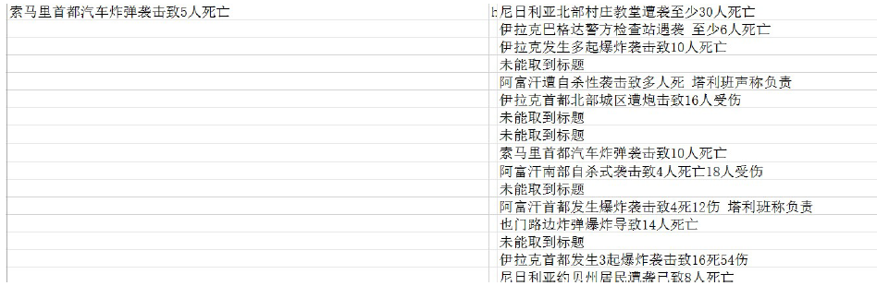
Application 1 文档相似性

Slide 31
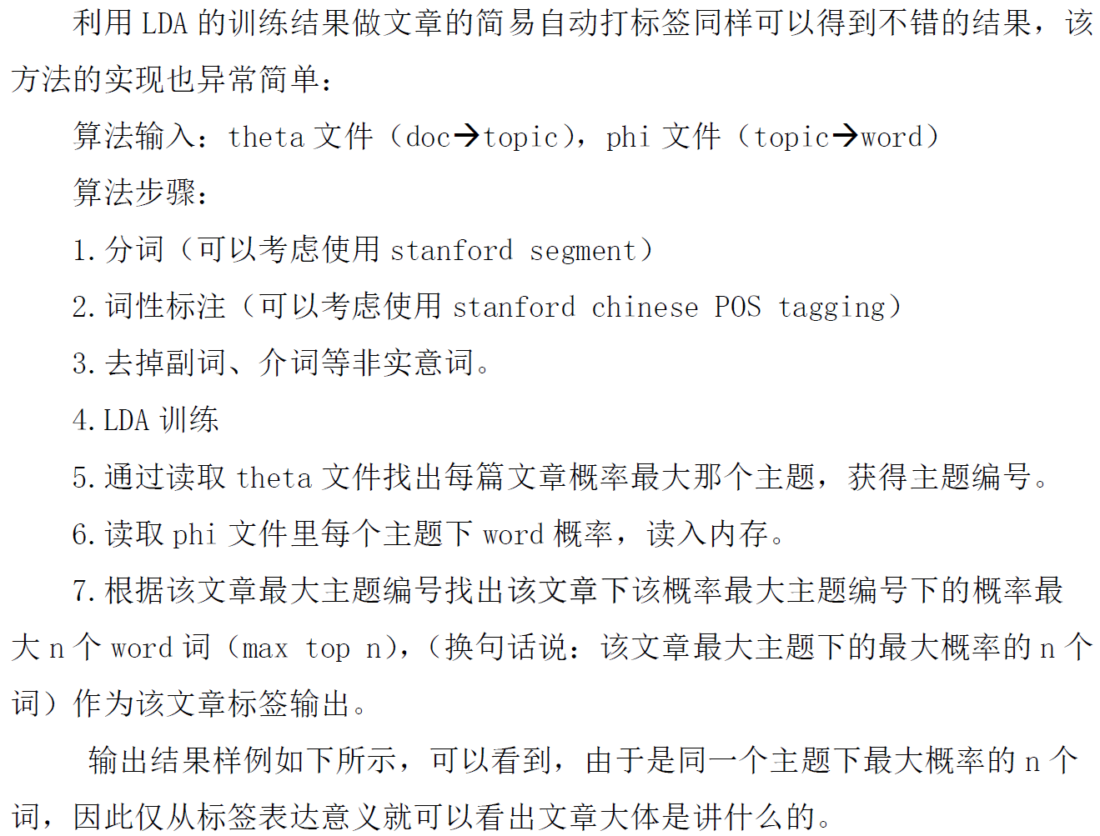
Application 2 自动标签

Slide 32
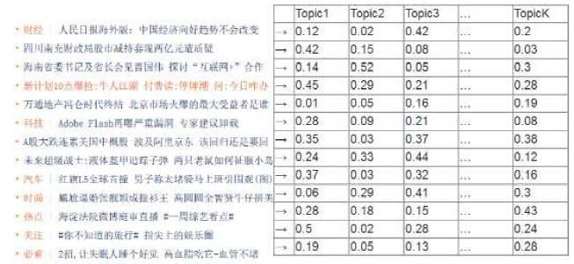
Application 3 推荐算法
常见的个性化新闻推荐手段有基于关键词的，基于新闻频道栏目的等，但是基于关键词的由于粒度较细，不太容易满足推荐系统的“多样性”，而基于喜爱栏目（比如NBA）的个性化推荐粒度又太粗，所以就比较有必要研究基于主题的推荐系统了。

Slide 33
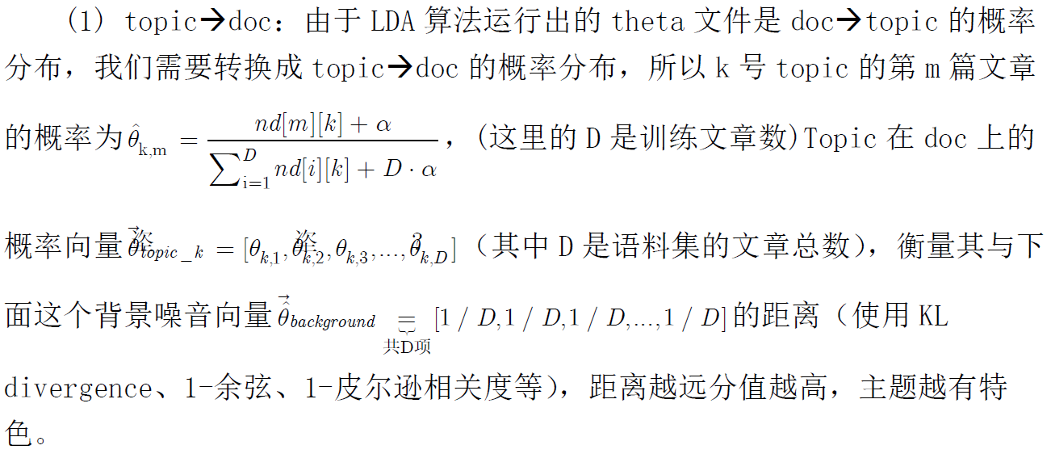
Application 4 主题排序

Slide 34
Topic Modeling
LSI、HDP、……

Slide 35
Topic Modeling
Using Gensim

Slide 36
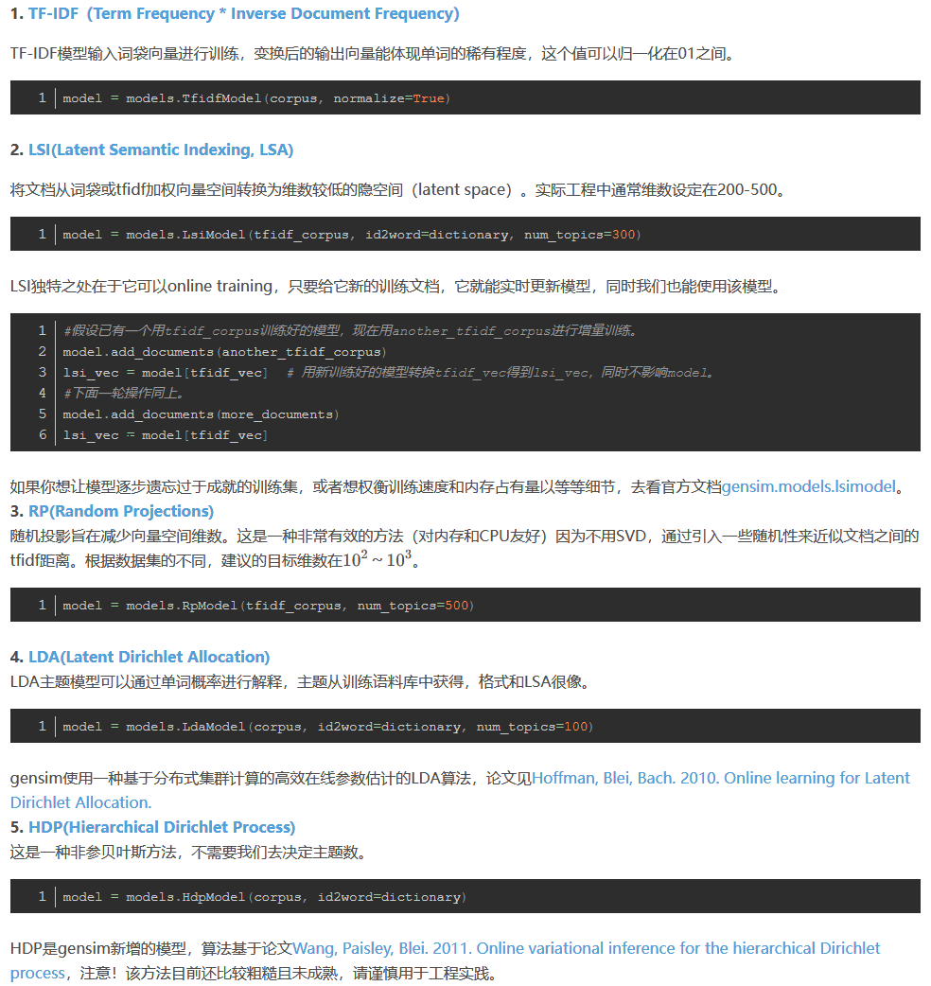
TF-IDF

Slide 37
LSI

Slide 38
RP

Slide 39
LDA

Slide 40
HDP

Slide 41
Topic Modeling
Using Gensim

